Slide 1

Notes:
1st slide (Mandatory)

Slide 2



Slide 3
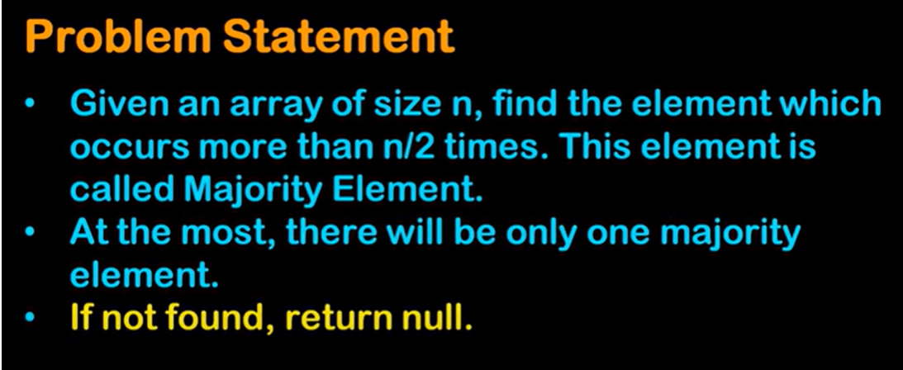

Slide 4
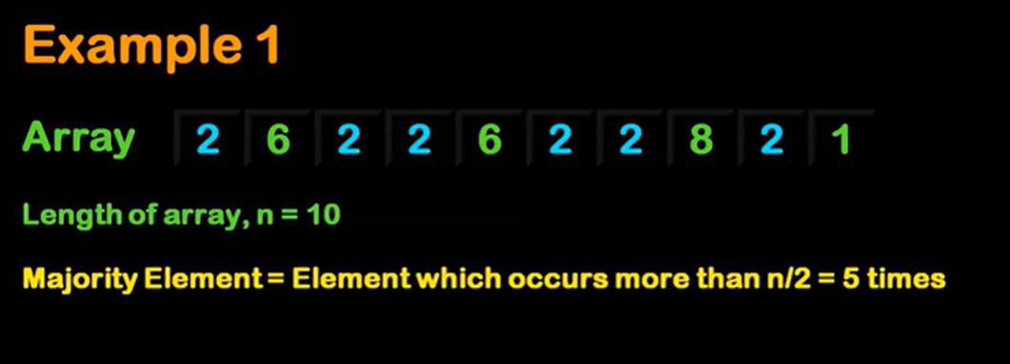
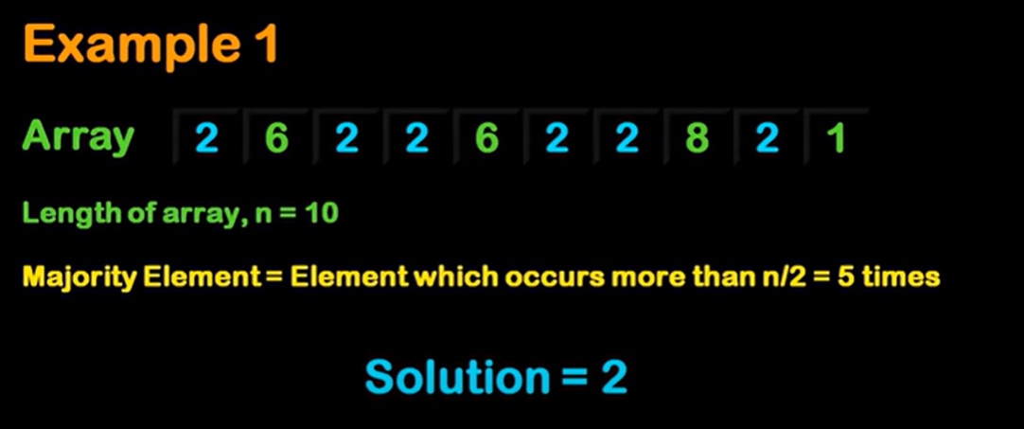

Slide 5
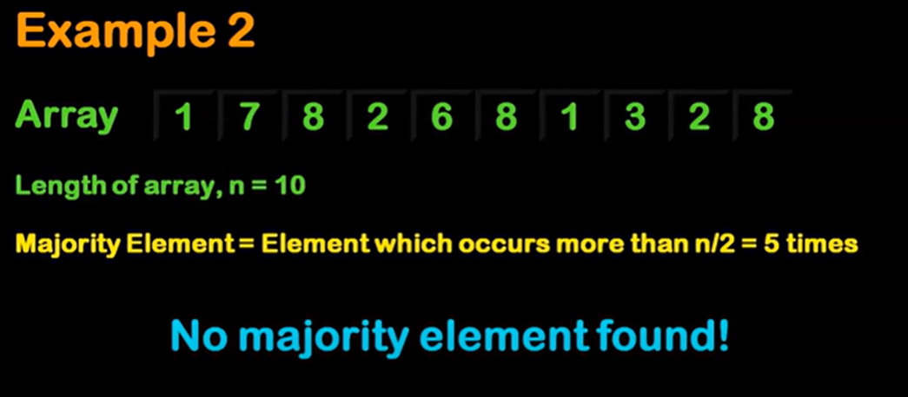

Slide 6


Slide 7
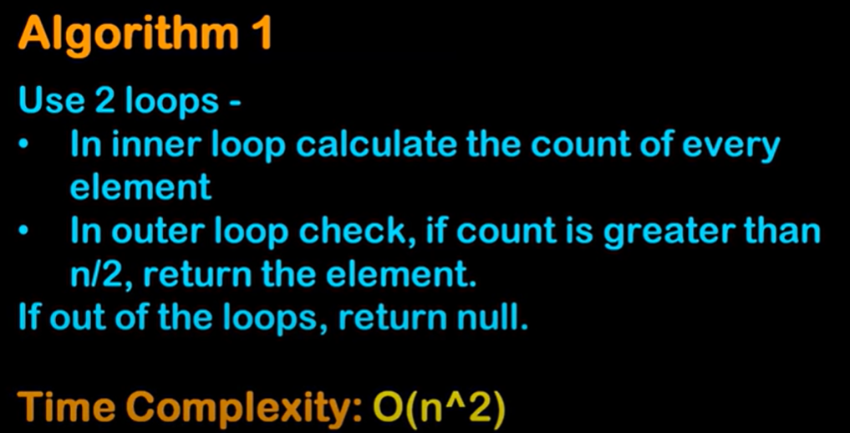

Slide 8


Slide 9
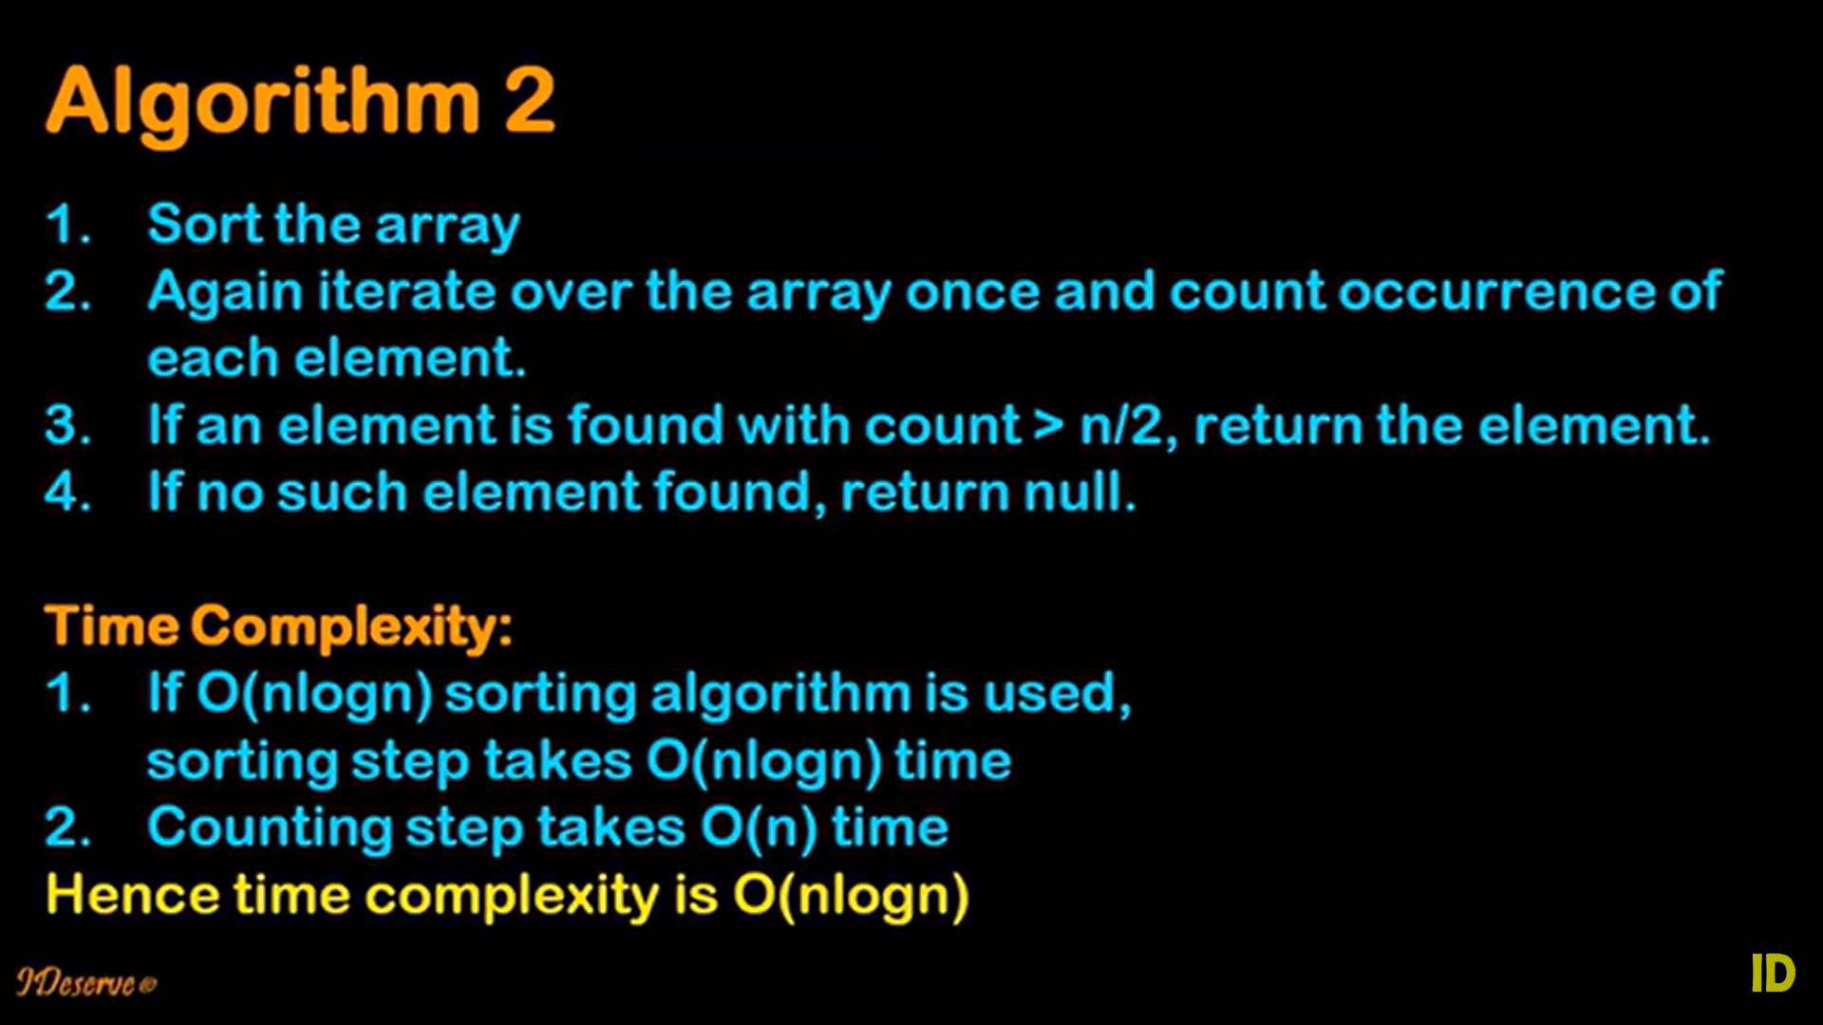

Slide 10


Slide 11
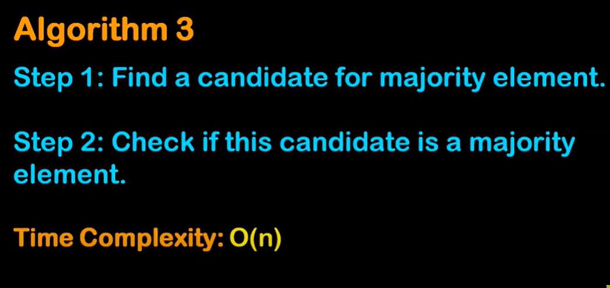

Slide 12
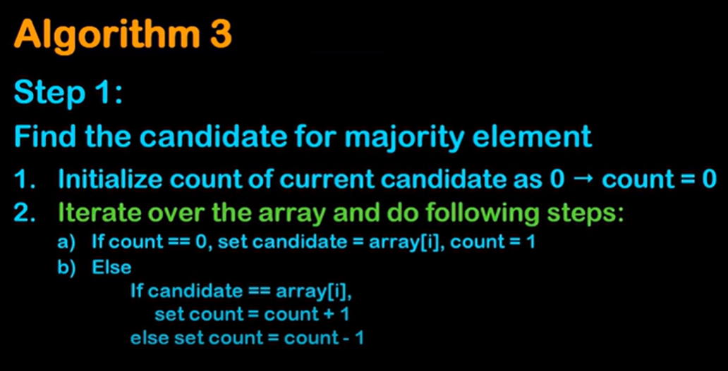

Slide 13
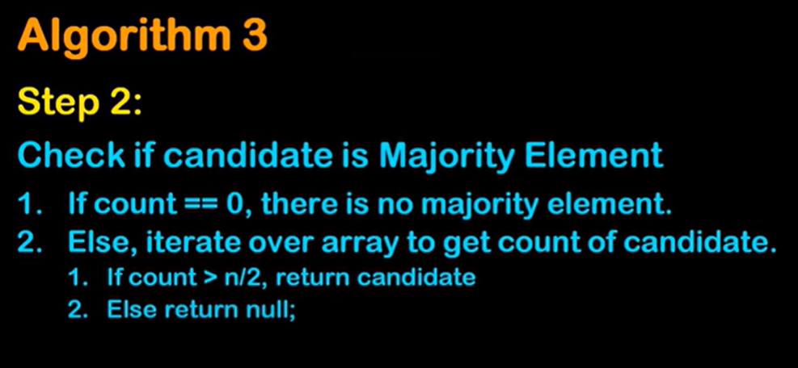

Slide 14
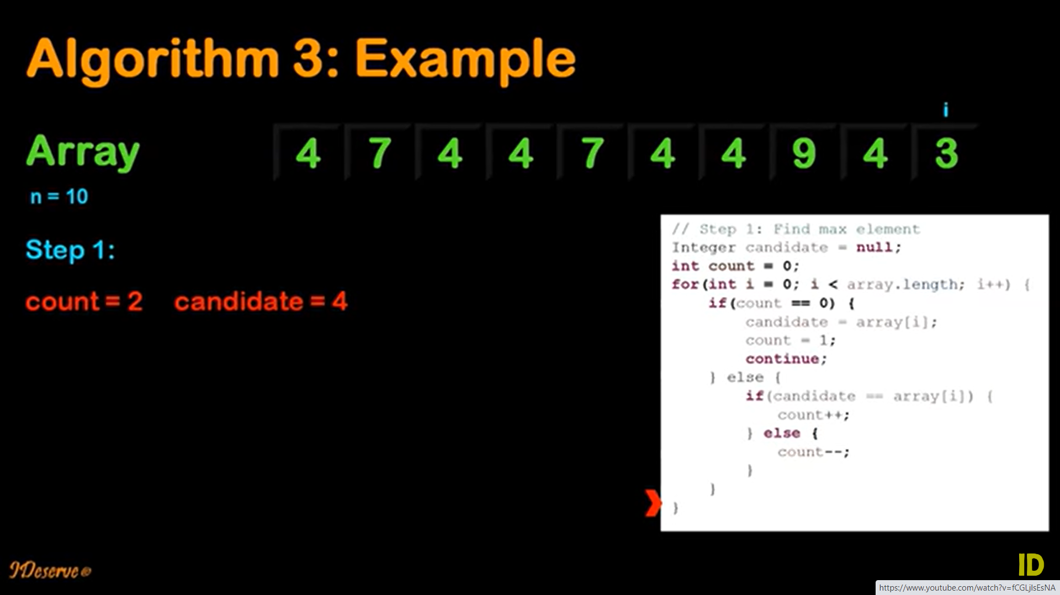

Slide 15
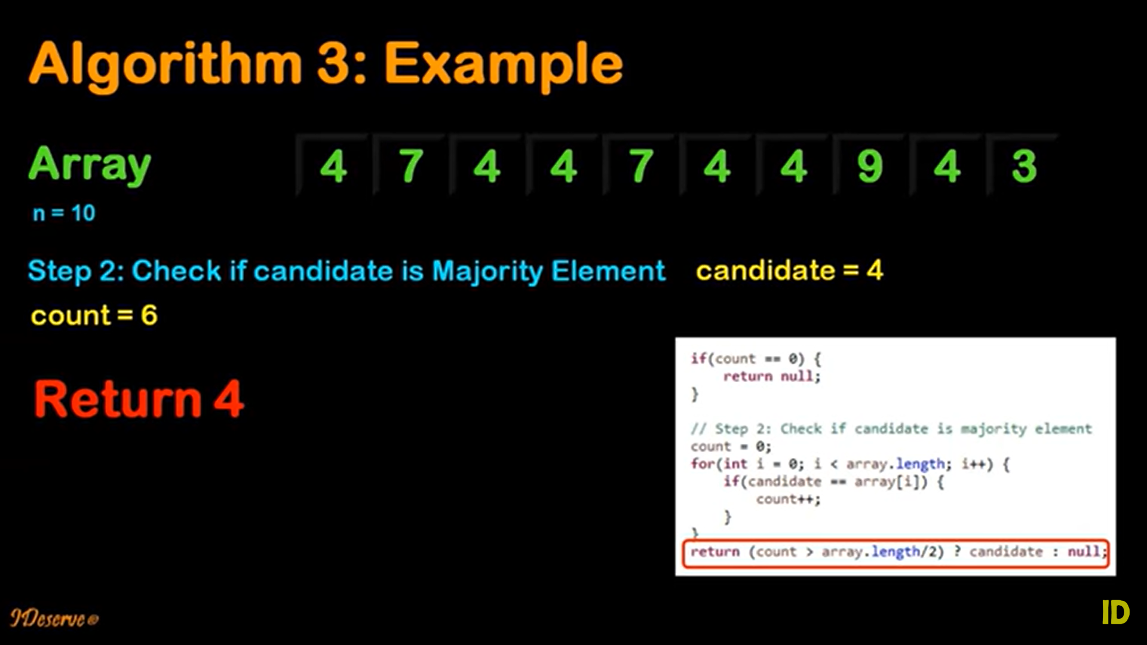

Slide 16
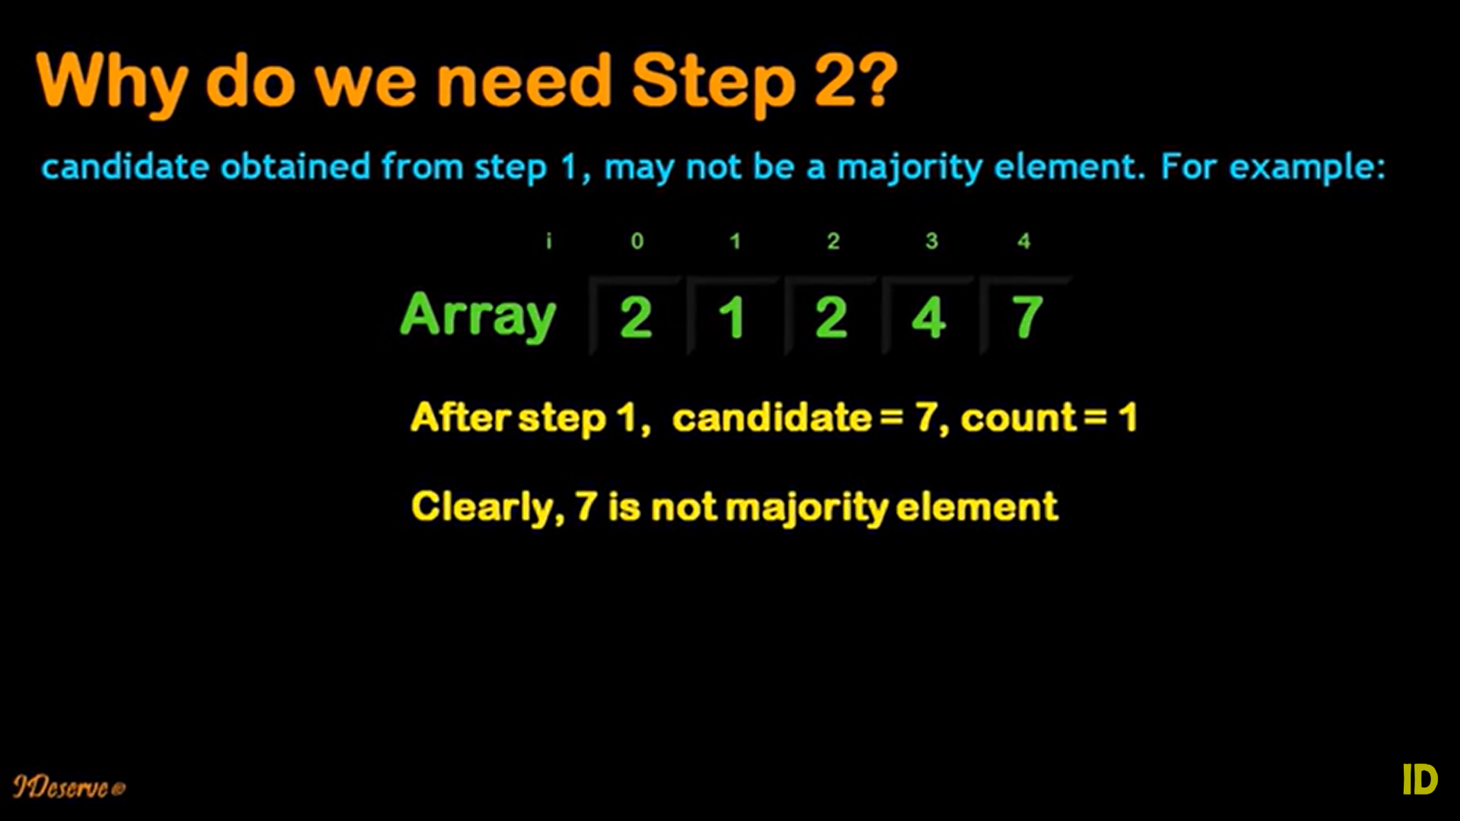

Slide 17
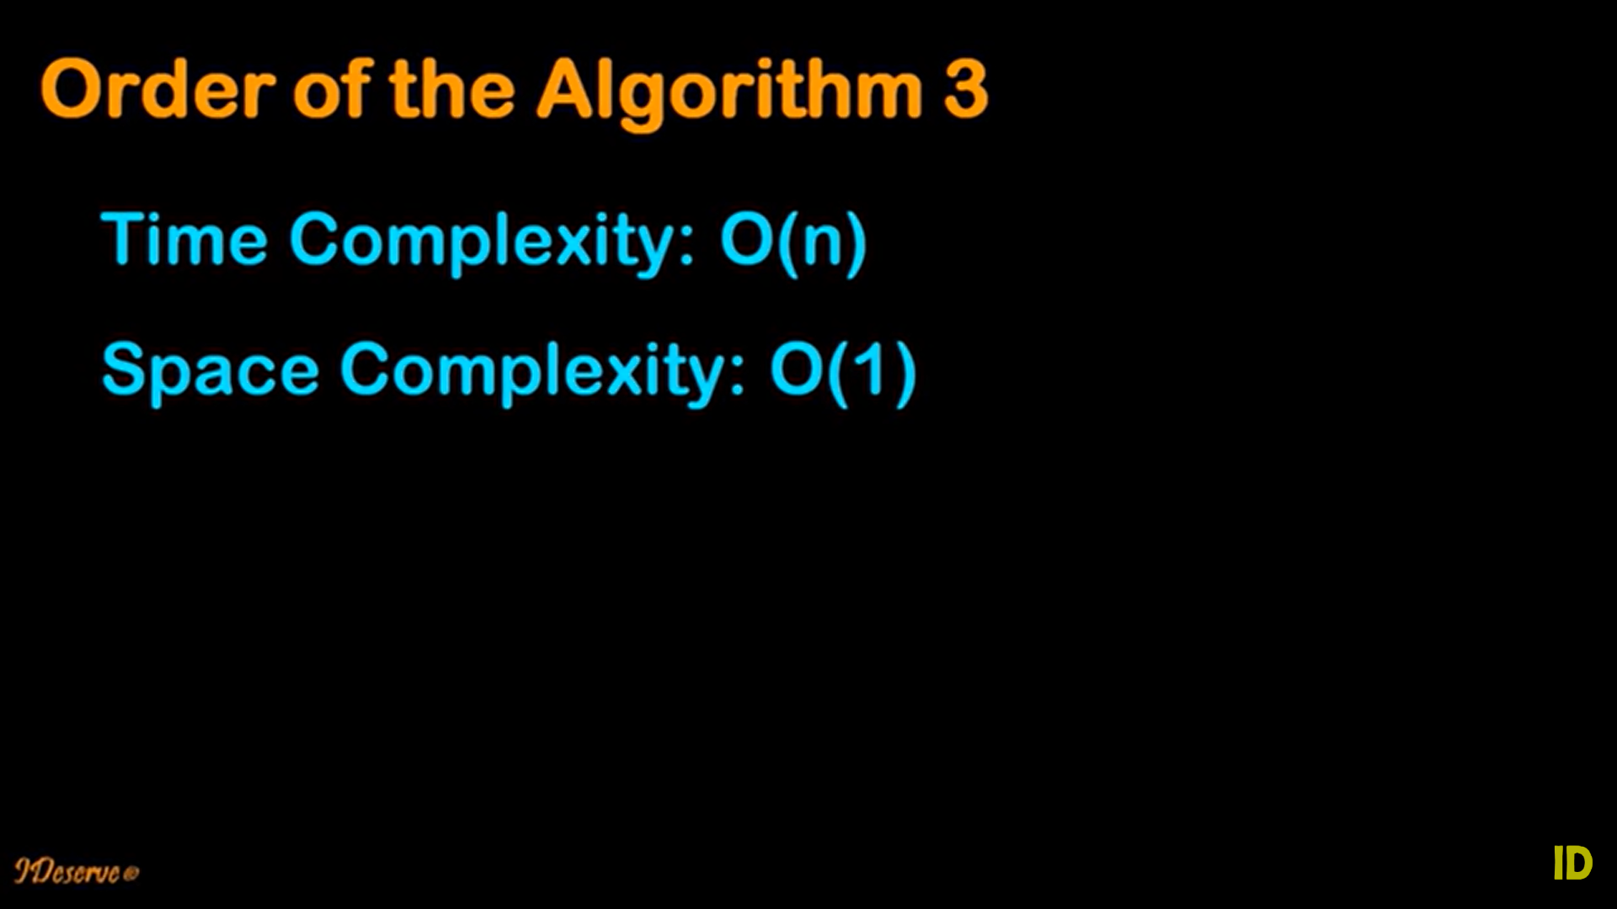

Slide 18
public class MajorityElement {
2
3 public static int findMajorityElement(int[] nums) {
4 int candidate = 0;
5 int count = 0;
6
7 for (int num : nums) {
8 if (count == 0) {
9 candidate = num;
10 count = 1;
11 } else if (candidate == num) {
12 count++;
13 } else {
14 count--;
15 }
16 }
17
18 // Verify the candidate
19 int majorityCount = 0;
20
21 for (int num : nums) {
22 if (num == candidate) {
23 majorityCount++;
24 }
25 }
26
27 if (majorityCount > nums.length / 2) {
28 return candidate;
29 }
30
31 return -1; // No majority element found
32 }
33
34 public static void main(String[] args) {
35 int[] nums = {3, 2, 3};
36 int majorityElement = findMajorityElement(nums);
37
38 if (majorityElement != -1) {
39 System.out.println("Majority element: " + majorityElement);
40 } else {
41 System.out.println("No majority element found.");
42 }
43 }
44 }

Slide 19

THANK YOU

